Slide 1
Tutorial 10 Q3
Supplementary Slides for Explanation of Solution
**Use presentation mode as timing diagram is animated.

Slide 2
Can you explain the outputs in State ONE / TWO?

Slide 3
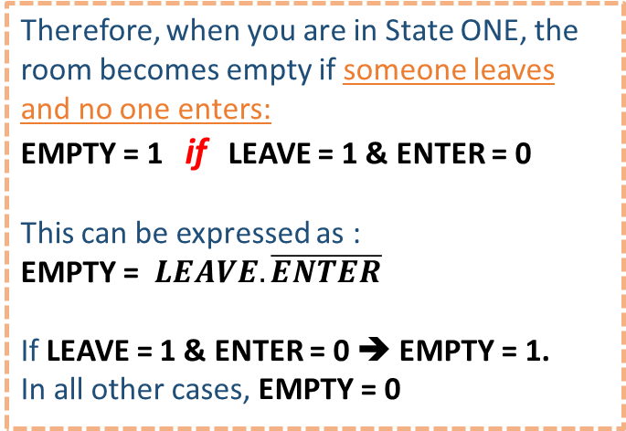
Assuming that there’s currently one person in the room, and you are in state ONE.
CLK
State
ONE
ONE
ZERO
Therefore, when you are in State ONE, the room becomes empty if someone leaves and no one enters:
EMPTY = 1 if LEAVE = 1 & ENTER = 0
This can be expressed as :
EMPTY = $LEAVE.\overline{ENTER}$
If LEAVE = 1 & ENTER = 0 ➔ EMPTY = 1.
In all other cases, EMPTY = 0
The next state will be ZERO.
Input
LEAVE
Nobody leaves or enters, next state is the same.
Halfway through this clock cycle, someone leaves the room. If nobody enters the room in this cycle, there is now nobody in the room.
Input
ENTER
Output
EMPTY
EMPTY must be updated to ‘1’ immediately.
To fulfil the following condition :
The EMPTY and FULL signals should be asserted as soon as the conditions are satisfied, i.e.
before the next active clock transition.

Slide 4
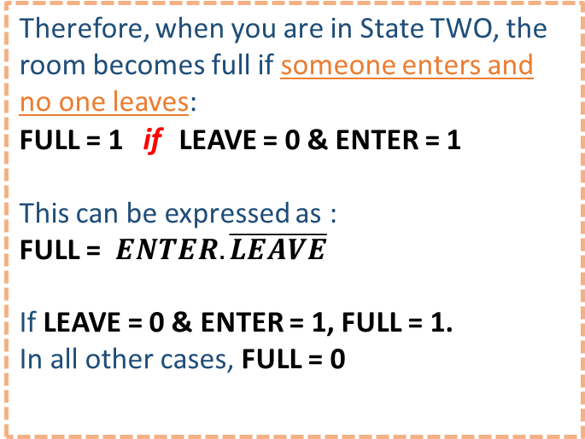
Assuming that there’s currently TWO people in the room, and you are in state TWO.
CLK
State
TWO
TWO
THREE
Therefore, when you are in State TWO, the room becomes full if someone enters and no one leaves:
FULL = 1 if LEAVE = 0 & ENTER = 1
This can be expressed as :
FULL = $ENTER.\overline{LEAVE}$
If LEAVE = 0 & ENTER = 1, FULL = 1.
In all other cases, FULL = 0
The next state will be THREE.
Input
ENTER
Nobody leaves or enters, next state is the same.
Halfway through this clock cycle, someone enters the room. If nobody leaves the room in this cycle, the room is now full.
Input
LEAVE
Output
FULL
FULL must be updated to ‘1’ immediately.
To fulfil the following condition :
The EMPTY and FULL signals should be asserted as soon as the conditions are satisfied, i.e.
before the next active clock transition.

